Slide 1
Different Countries…Different People… Different opinions
By
Sarat kiran Andhavarapu
ShanMUKH YadlapalLi

Slide 2
Outline
What we wanted to do.
What did we take.
What did we do.
What did we get.
What else can be done.

Slide 3
What we wanted to do
The focus of the project is to investigate
how people from different countries react to a situation/event
if the opinions of people change with time and/or within countries for a similar situation/event.
For this we took two trends in technology – Iphone 4S and Iphone 5S twitter data
Countires taken into account – USA and INDIA

Slide 4
What did we take ?
Twitter data :
Iphone 4S - October 4th – October 15th 2013 ( 42 GB)
Iphone 5S - September 10th – September 20th 2013 (148 GB)
Total Number of tweets analyzed - 75 Million tweets
Thank You Dr.Lee

Slide 5
What did we do ?
Using geo-location to location information
Acquiring relevant tweets
Analyzing the emoticons
Understanding their tweets
Using picture features to understand their feeling

Slide 6
Using geo-location to location information
From 75 millions tweets we acquired two sets of data:
1. English language tweets with country as US
2. English language tweets with country as INDIA

Slide 7
Acquiring relevant tweets with hashtags
We composed our own training set of words to extract tweets
(Including fingerprint, touched, touch id, 64 bit, iphone 5s,gold color, champagne..)
In hashtags.
hashtag = [ hashtag['text'] for hashtag in hastagb ]
with open(‘dataset.csv', 'rb') as total:
csvreader = csv.reader(total)
for row in csvreader:
if count <1 :
if linnne.find(row[0]) > -1:
count +=1
print linnne
text_file.write("{}".format(line))
lengths+=1

Slide 8
Acquiring relevant tweets with text
Similarly for the text
We composed our own training set of words to extract tweets
(Including fingerprint, touched, touch id, 64 bit, iphone 5s,gold color, champagne..)
from the tweet text
This resulted in few miscellaneous (not relevant) tweets

Slide 9
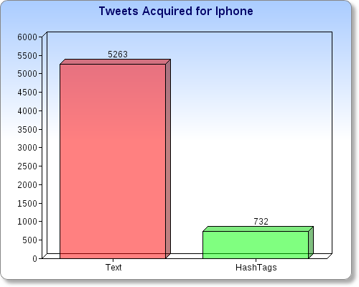
Tweets acquired

Slide 10
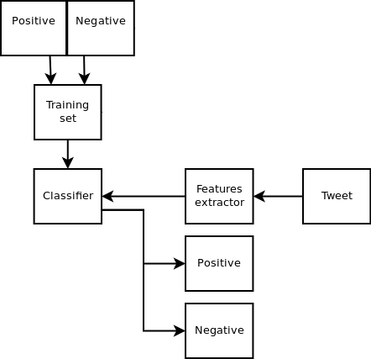
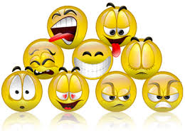
Analyzing the emoticons
pos_emoticons = [':-)', ':)', '(-:', '(:', 'B-)', ';-)', ';)']
neg_emoticons = [':-(', ':(', ')-:', '):']

Slide 11
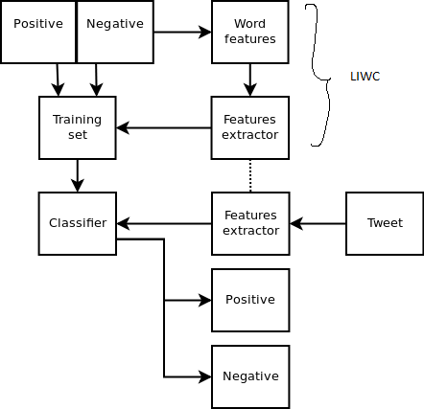
Understanding their tweets
Used LIWC (Linguistic Inquiry and Word Count) to analyze the tweets.
First tokenize the words , find the length
Process them word wise .
pos_score = pos_count/word_count
neg_score = neg_count/word_count

Slide 12

Using picture features to understand their feeling
Each photo is represented by a feature vector consisting of vector quantized SURF features
capturing visual image properties
Used Amazon EC2 (cloud services) to evaluate the images and run SURF algorithm
The output consisted of number of feature points it matched and top 5 results of image

Slide 13
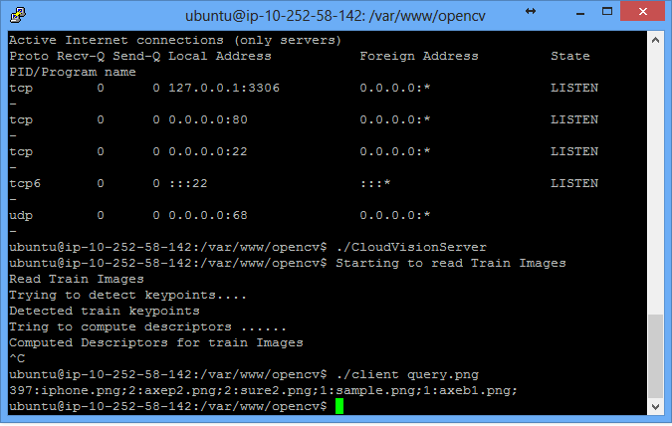
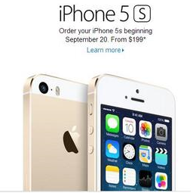
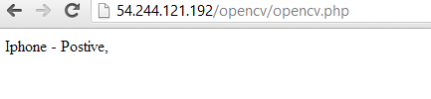
Using picture features to understand their feeling
The output consisted of number of feature points it matched and top 5 results of image

Slide 14
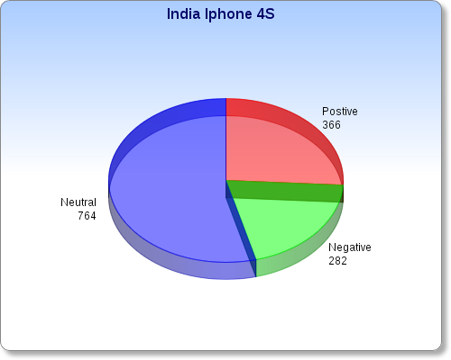
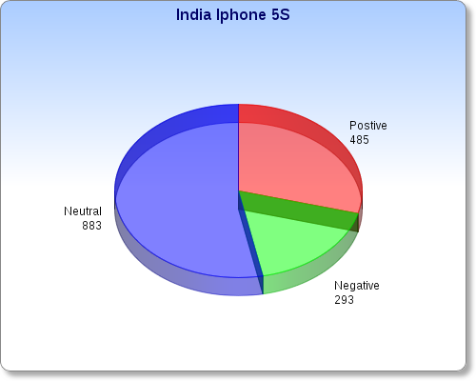
INDIA 4S and INDIA 5S

Slide 15
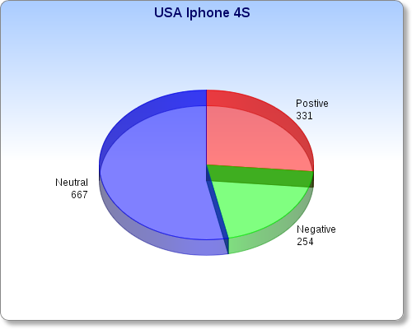

USA Iphone 4S and Iphone 5S

Slide 16
Iphone 4S India Vs USA

Slide 17
Iphone 5S India Vs USA

Slide 18
What else can be done ?
In future we can
Expand this to different countries
Analysis more number of tweets
Take different languages into account
Better training sets

Slide 19
References
References:
1) Apoorv Agarwal, Boyi Xie, Ilia Vovsha, Owen Rambow and Rebecca Passonneau
Sentiment Analysis of Twitter Data
2) James Spencer and Gulden Uchyigit
Sentimentor: Sentiment Analysis of Twitter Data
3) Jaram Park, Vladimir Barash, Clay Fink and Meeyoung Cha
Emoticon Style: Interpreting Differences in Emoticons Across Cultures
4) http://www.quora.com/Sentiment-Analysis/Is-there-any-algorithm-for-sentiment-analysis-on-emoticons

